Slide 1

CHRISTU JYOTHI INSTITUTE OF TECHNOLOGY &SCIENCE Affiliated to JNTUH/ Jangaon, Telangana - 506167 Department Of Computer Science Engineering A Mini Project Presentation On Stock Price Fluctuations Using Machine Learning
Presented by
K. PRIYAVARSHITHA - 22681A0552
K. INRAJU - 22681A0545
E. MADHU - 22681A0527
B. SHIVA - 22681A0512
Guided by
DR. P. U. ANITHA(Assoc.prof)
HOD
Mr. M. RAMARAJU(Ass.prof)

Slide 2
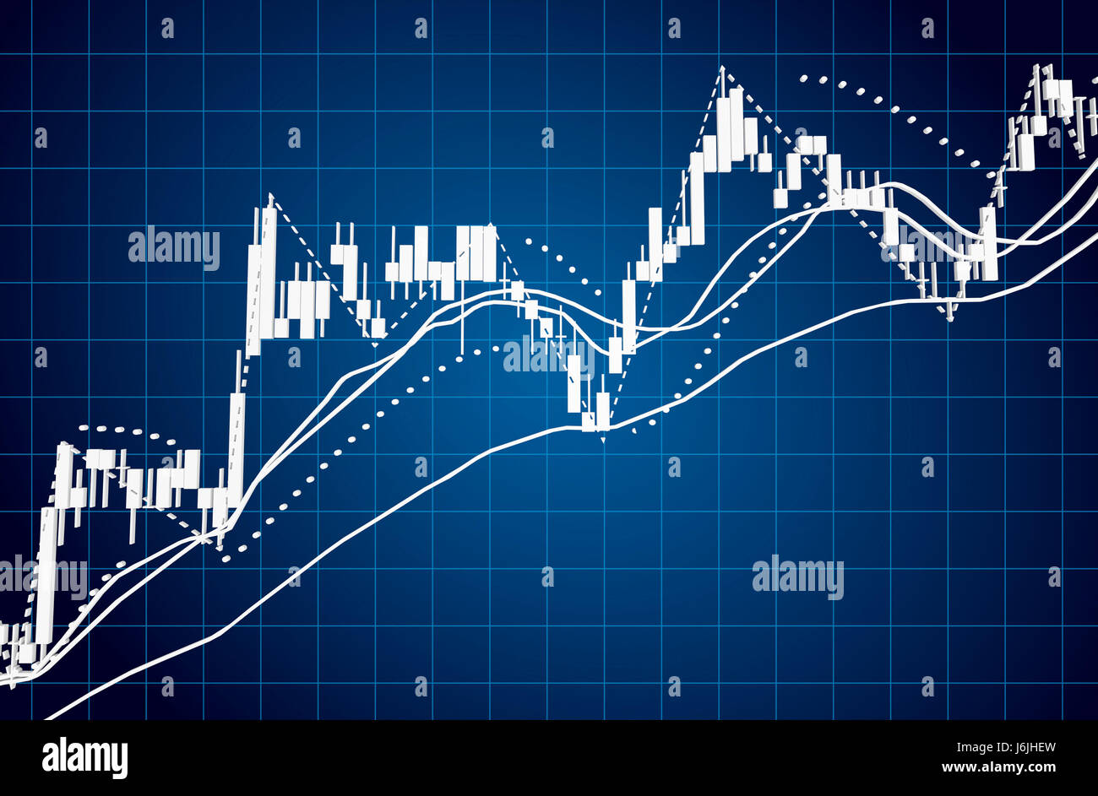

TITLE Stock Price Fluctuations Using Machine Learning

Slide 3

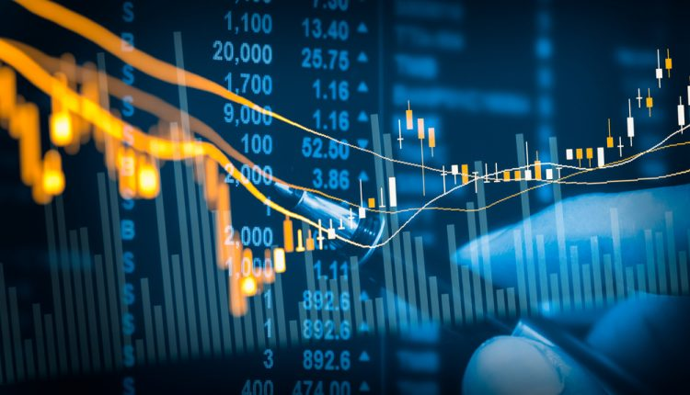
CONTENTS
1 . INTRODUCTION
2 . LITERATURE SURVEY
3 . EXISTING SYSTEM
4 . PROPOSED SYSTEM
5 . MODULES
6 . DATA FLOW DIAGRAM
7 . SOFTWARE AND HARDWARE REQUIREMENTS
8 . OUTPUT SCREENS
9 . CONCLUSION
10 . FUTURE ENHANCEMENT

Slide 4
ABSTRACT
This project explores the predictive capabilities of machine learning in analyzing stock price fluctuations. By leveraging financial indicators like EPS, P/E ratio, D/E ratio, and revenue growth, the system aims to establish meaningful correlations to improve forecasting. Using techniques like regression models, neural networks, and natural language processing, historical and real-time data are used to predict market trends, offering investors a data-driven decision-making framework. This system provides a foundation for integrating real-time analytics with financial forecasting. The AI-driven approach allows adaptive learning from market behavior, increasing the relevance and accuracy of predictions. It addresses the shortcomings of traditional models by providing dynamic insights. By combining supervised and unsupervised learning techniques, it ensures robust analysis. The system can be scaled to multiple stock exchanges and adapted for diverse portfolios. The study's implications extend to institutional investors and financial analysts seeking better forecasting tools.

Slide 5
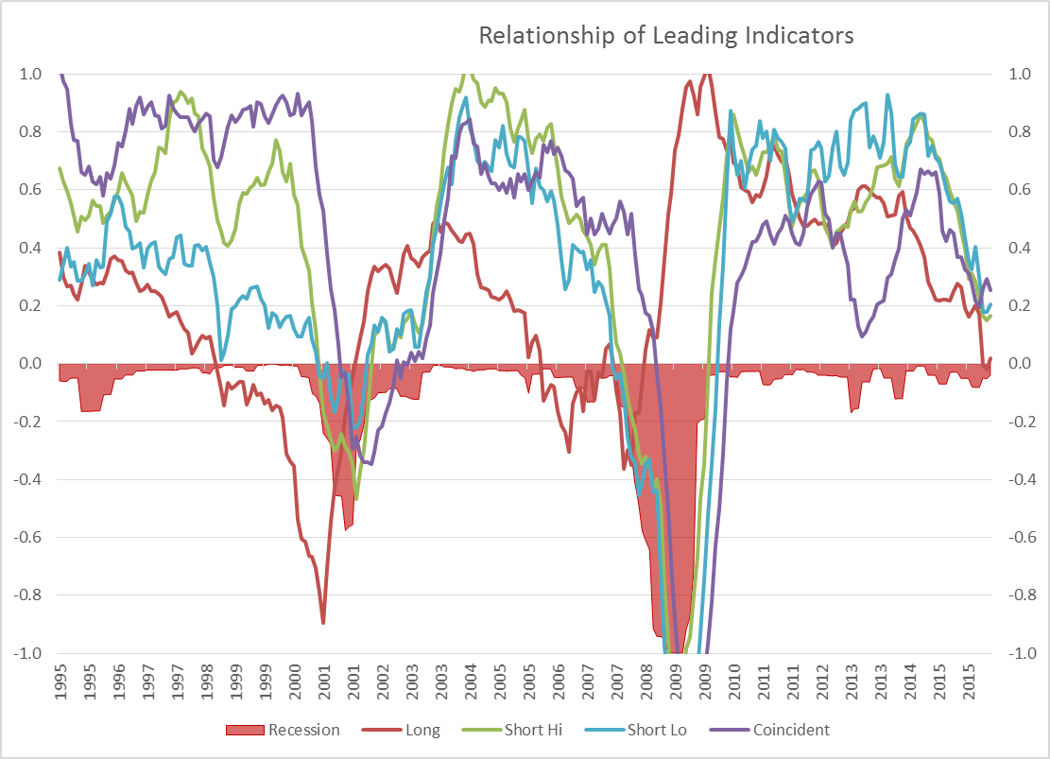
1. INTRODUCTION
The stock market exhibits complex, non-linear behavior driven by numerous macroeconomic, technical, and psychological factors. Traditional statistical models often fall short in capturing these intricate dynamics, making accurate prediction of stock price movements a longstanding challenge. The lack of reliable forecasting tools limits investors’ ability to make informed decisions, emphasizing the need for advanced approaches that can effectively analyze vast, multidimensional financial data. With the rise of big data and advancements in artificial intelligence, machine learning has emerged as a powerful technique for analyzing financial markets. Its ability to learn from historical patterns, adapt to changing conditions, and handle complex relationships among variables presents new opportunities for market prediction. The motivation behind this project is to harness the predictive capabilities of machine learning to analyze correlations between financial indicators and stock price fluctuations, thereby improving the precision and reliability of forecasting models.

Slide 6
2. LITERATURE SURVEY
Proceedings of the 2023 International Conference on Management Research and Economic Development DOI: 10.54254/2754-1169/22/20230307 Research on the Stock Price Prediction Using Machine Learning Yang Shi1,a.
Stock Price Prediction Using Machine Learning Strategies, Xinran Chen* Dept. of Mathematics, University of Washington, Seattle, United States.
Applying machine learning algorithms to predict the stock price trend in the stock market– The case of Vietnam Tran Phuoc1,2, Pham Thi Kim Anh1,2, Phan Huy Tam3,4 & Chien V. Nguyen
Forecasting Stock Market Prices Using Machine Learning and Deep Learning Models: A Systematic Review, Performance Analysis and Discussion of Implication Gaurang Sonkavde, Deepak Sudhakar Dharrao.
Stock Market Prediction with High Accuracy using Machine Learning Techniques Malti Bansal*, Apoorva Goyal, Apoorva Choudhary.

Slide 7
3. EXISTING SYSTEM
The stock market is the fuzzy environment full of many uncertain factors. The existence of these uncertain factors makes people face various risks when investing in securities. The stock market is a very complex system, which is affected by economic, policy and market factors. In existing system, we are used linear regression algorithm for stock price prediction. In the existing system, Linear Regression is used as the machine learning algorithm for predicting stock prices. Linear Regression is a supervised learning algorithm that models the relationship between the independent variables (features) and the dependent variable (stock price) by fitting a straight line (called the regression line).
DISADVANTAGES OF EXISTING SYSTEM:
Using linear regression algorithm we cannot predict exact stock price values.
It involves very lengthy and complicated procedure of calculations and analysis.
Higher Mean Squared Error (MSE) and Mean Absolute Error (MAE) compared to other advanced algorithms.
Algorithm: Linear regression

Slide 8
4. PROPOSED SYSTEM
The proposed system replaces Linear Regression with the Random Forest algorithm for improved prediction performance. Random Forest is an ensemble learning method that constructs multiple decision trees during training and outputs the average of predictions for regression tasks.
ADVANTAGES OF PROPOSED SYSTEM:
Using Random Forest Algorithm, we can get the output with Maximum Accuracy.
Lower MSE = 0.11, indicating better performance.
Improved accuracy due to reduced error rate.
More adaptable to real-world stock price trends, which are often non-linear and affected by multiple factors.
Algorithm: Random Forest Algorithm

Slide 9
5. MODULES
1. Data Collection Module
Purpose: To collect and load historical stock market data for model training and testing.
This module allows users or the system to import stock price data (e.g., from CSV files, APIs, or databases). It includes:
Historical price information (Open, High, Low, Close, Volume)
2. Data Preprocessing Module
Purpose: To clean, transform, and prepare the data for machine learning algorithms.
Handles missing values
Normalizes/standardizes features
Splits the data into training and testing sets
3. Feature Selection Module
Purpose: To select the most relevant input features for prediction.
Identifies and selects key attributes that influence stock prices
Removes irrelevant/noisy data
May include correlation analysis or feature importance from Random Forest

Slide 10
5. MODULES
4. Model Training Module
Purpose: To train the machine learning model using the preprocessed data.
Trains selected ML algorithms (e.g., Random Forest, Neural Network)
Hyperparameter tuning to optimize performance
5. Prediction Module
Purpose: To forecast future stock prices based on the trained model.
Accepts new input data
Uses the trained model to generate price predictions
6. Visualization Module
Purpose: To display prediction results in an easy-to-understand format.
Accepts new input data
Uses the trained model to generate price predictions
7. Performance Evaluation Module
Purpose: To evaluate how well the model is performing.
Mean Absolute Error (MAE)
Root Mean Square Error (RMSE)

Slide 11
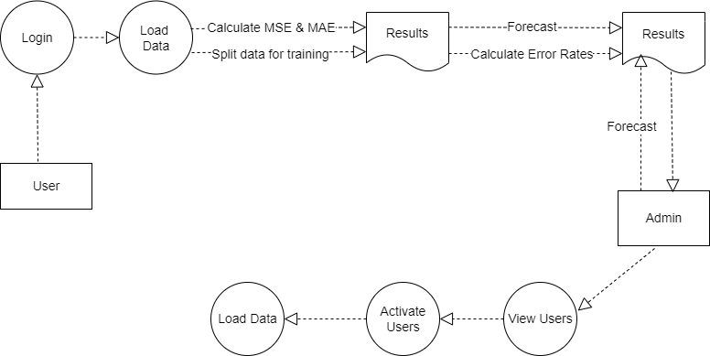
6. DATA FLOW DIAGRAM
Process:
- Stock Price Prediction System
Data Flows:
- User sends request for stock prediction
- System fetches historical data from external sources
- System returns predicted price/movement to the user
Processes:
1. Data Collection
2. Data Preprocessing
3. Feature Extraction
4. Model Training & Prediction
5. Result Evaluation & Visualization
External Entities:
- User
- Financial Data Source (APIs, CSV files, databases)

Slide 12
7. SOFTWARE AND HARDWARE REQUIREMENTS
SOFTWARE REQUIREMENTS :
HARDWARE REQUIREMENTS :
Python
Django
Windows 10 64-bit OS
Any Browser (Particularly Chrome)
1 . Processor: Intel i5
2 . RAM: 4 GB (min)
3 . Space on Hard Disk: minimum 1 TB

Slide 13
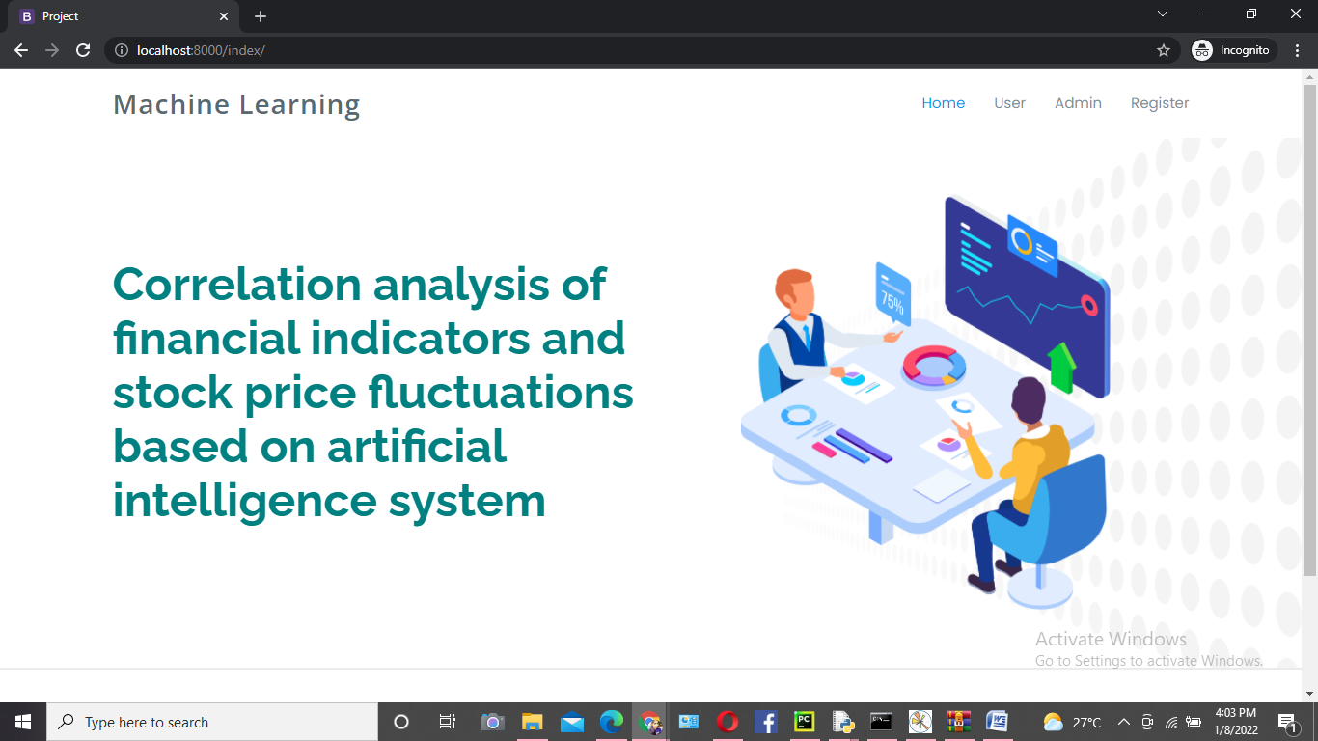
8 . OUTPUT SCREENS
HOME PAGE

Slide 14
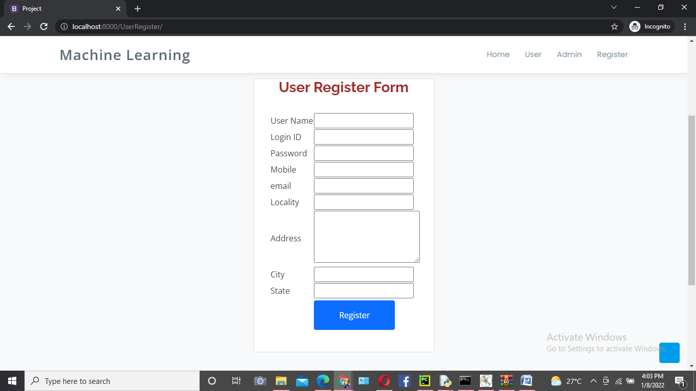
USER REGISTER FORM

Slide 15
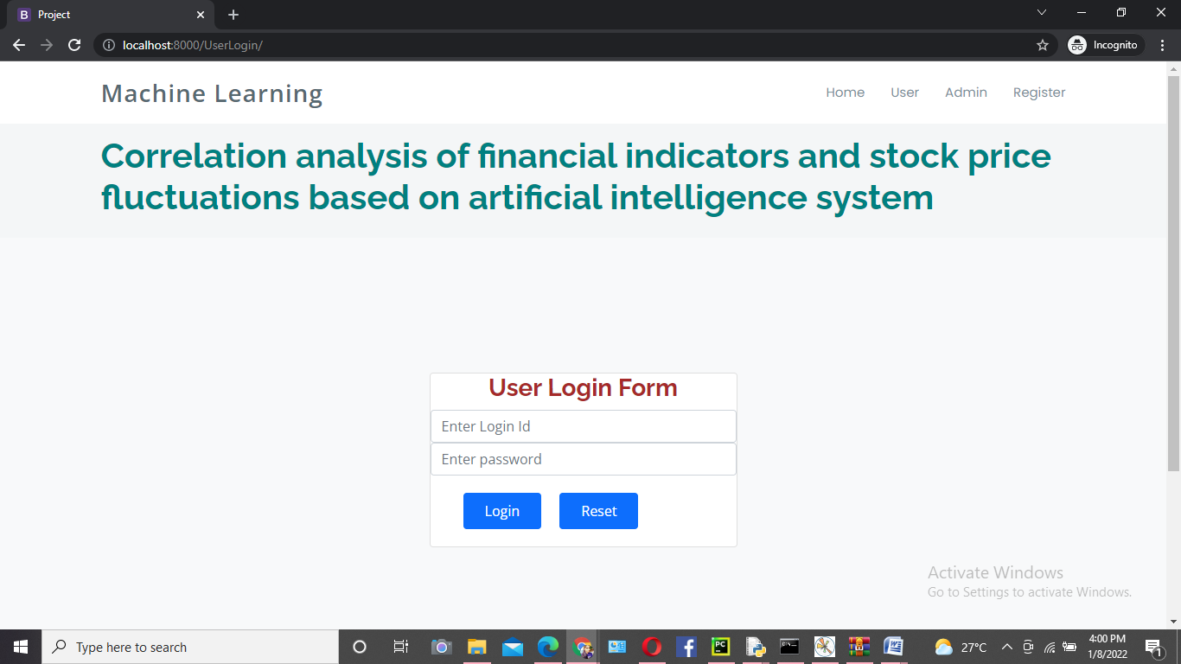
USER LOGIN FORM

Slide 16
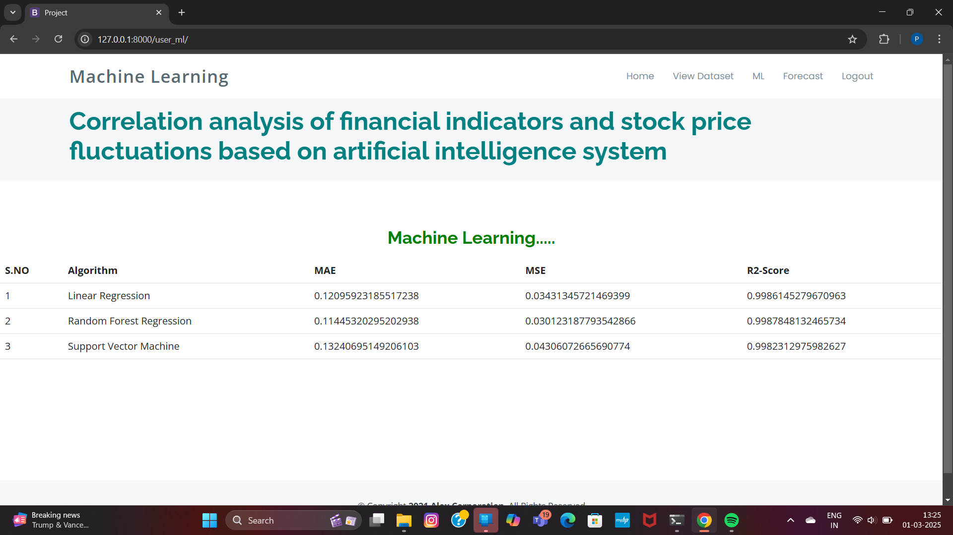
ALGORITHM

Slide 17
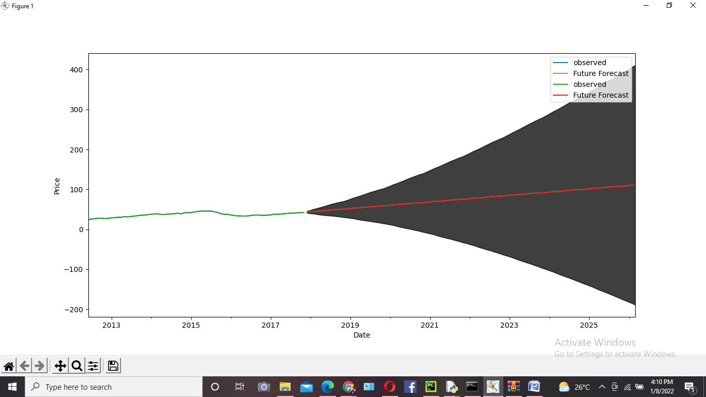
FORECAST

Slide 18
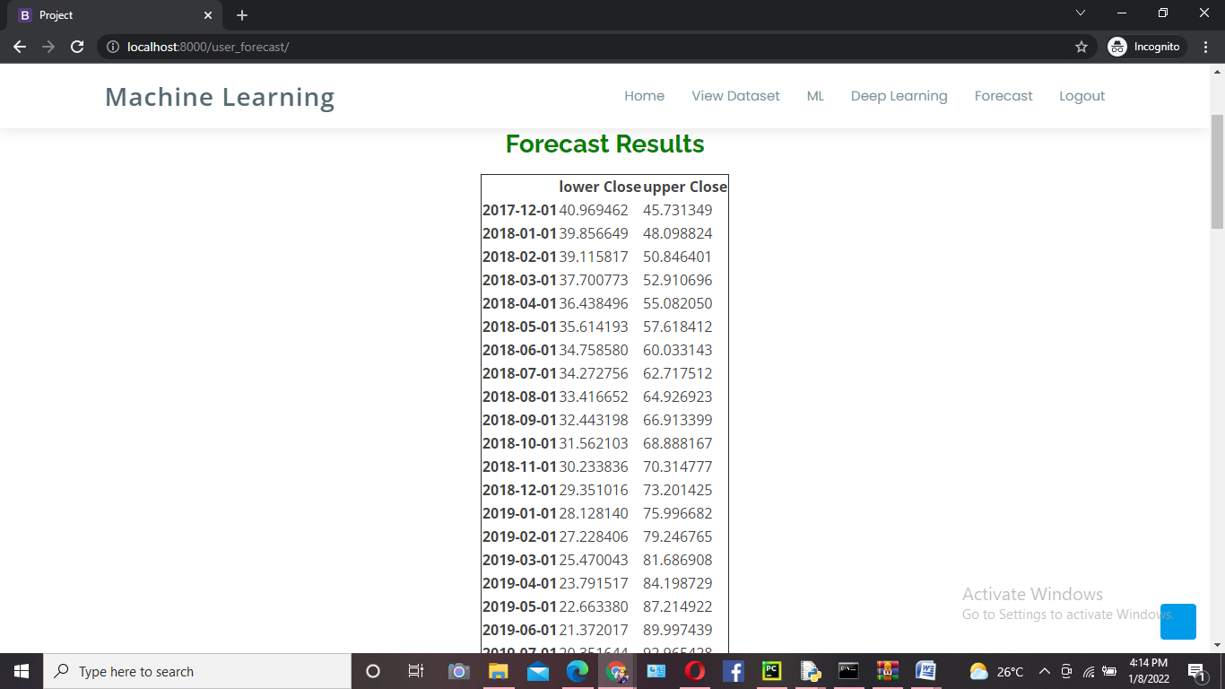
Forecast Results

Slide 19
9. CONCLUSION
This project demonstrates the potential of machine learning in predicting stock market behavior. By using ML models and financial indicators, the system identified patterns that assist investors in understanding market fluctuations. The results show promise for future enhancement with real-time data, sentiment analysis, and more advanced ML models. It also highlights the flexibility of machine learning when applied to real-time market prediction. The approach has proven scalable and suitable for integration with other financial data sources. This work serves as a foundation for building comprehensive financial forecasting tools and decision support systems.

Slide 20
10. FUTURE ENHANCEMENTS
Future enhancements include integrating LSTM, GRU, Transformers for time-series prediction, real-time prediction APIs, sentiment analysis using NLP, volatility modeling using GARCH, and explainability tools like SHAP and LIME. Back testing and multi-market analysis are also planned. Furthermore, integration with portfolio optimization strategies, user feedback loops for continuous model tuning, and exploration of reinforcement learning techniques could enhance system intelligence and decision-making capabilities.

Slide 21

THANK YOU … AND NOW IT’S TIME TO ADDRESS YOUR QUERIES

